Slide 1
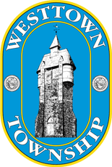
Session 5 Traffic & Transportation
Neighborhood University
October 6, 2016
Westtown Township

Slide 2
Presenters
Rob Pingar, P.E.
Township Manager & Director of Engineering
Westtown Township
Mark Gross
Director of Public Works
Westtown Township
Chris Patriarca, AICP
Planning Director & Zoning Officer
Westtown Township

Slide 3
Overview &Topics
Discussion of a comprehensive, coordinated, and effective approaches to transportation in the West Chester area.
Existing and proposed multi-modal transportation programs aimed at safely and efficiently moving people and goods throughout the area, consisting of the planning, design, construction, and maintenance of roads, bridges, bikeways, pedestrian facilities, parking facilities, and mass transit facilities.
Topics to be covered this evening include:
Overview of Township & Borough Responsibilities
Regional Planning
Multi-use Trails
Traffic Signals & Intersections
Other traffic control measures: Signs & Pavement markings

Slide 4
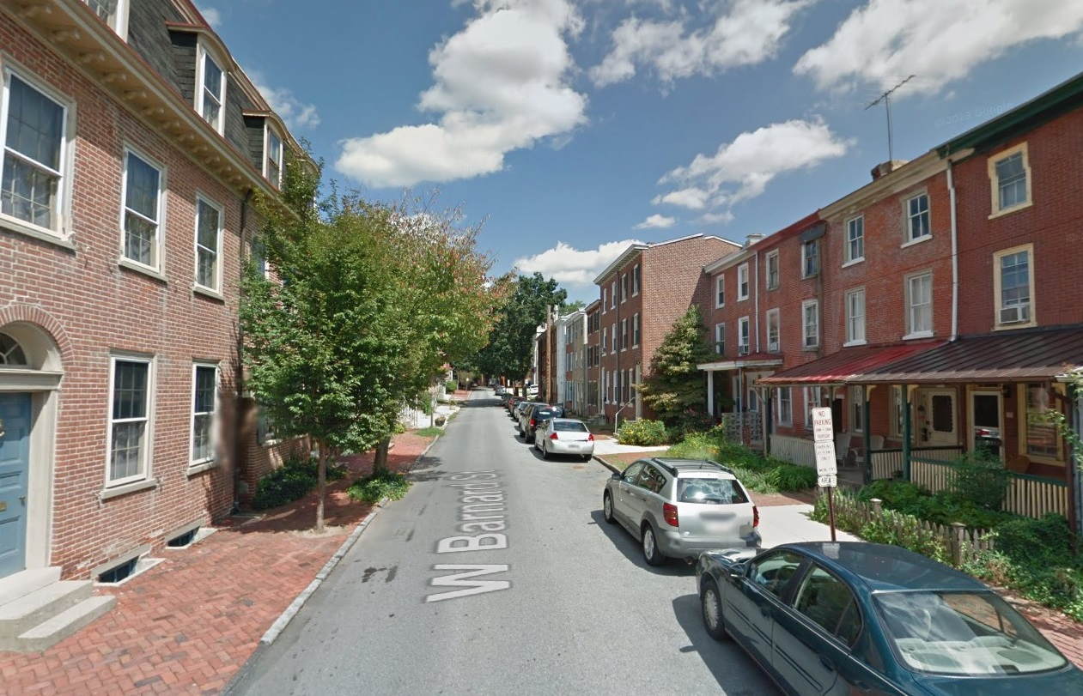
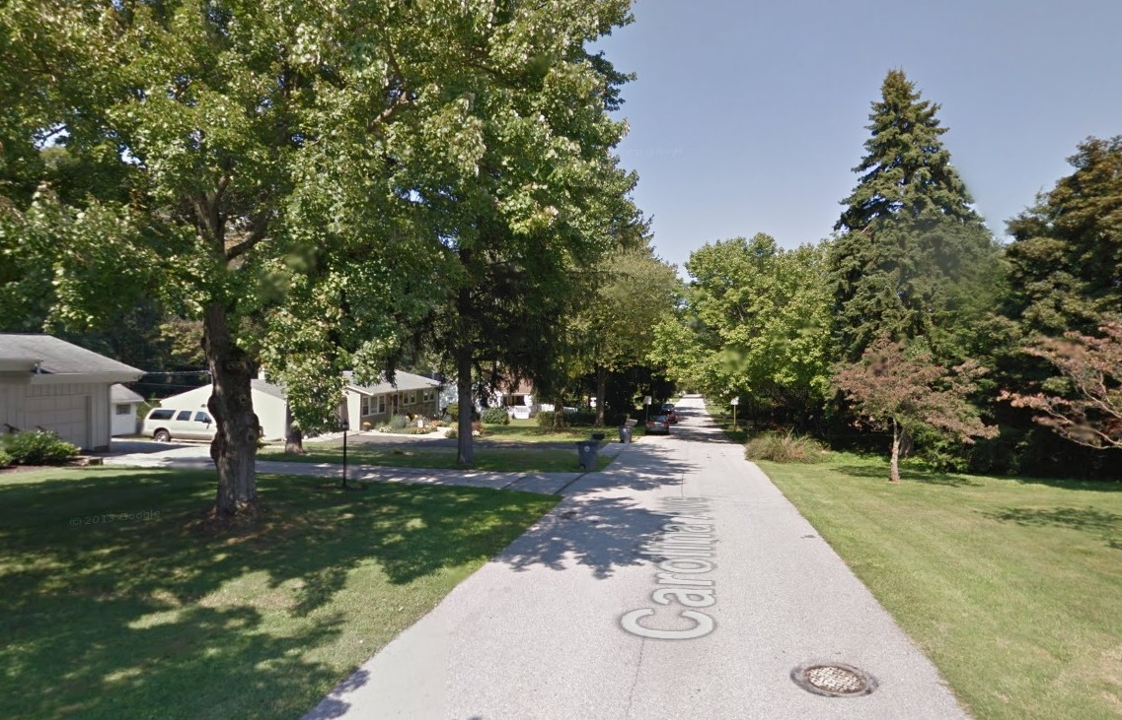
Local Roads

Slide 5
Road mileage totals
Within Chester County, approximately 1,000 of the total 4,600 miles of public roads are maintained by PennDOT with the rest under the maintenance of the localities.
Municipality | Local road mileage | State road mileage | Total mileage
Thornbury (Chester Co.) | 17.34 | 6.11 | 23.45
West Chester | 28.46 | 5.36 | 33.82
Westtown | 54.60 | 10.89 | 65.49
East Bradford | 56.72 | 18.43 | 75.15
East Goshen | 61.83 | 16.68 | 78.51
West Whiteland | 66.86 | 27.43 | 94.29
West Goshen | 91.15 | 28.50 | 119.65

Slide 6
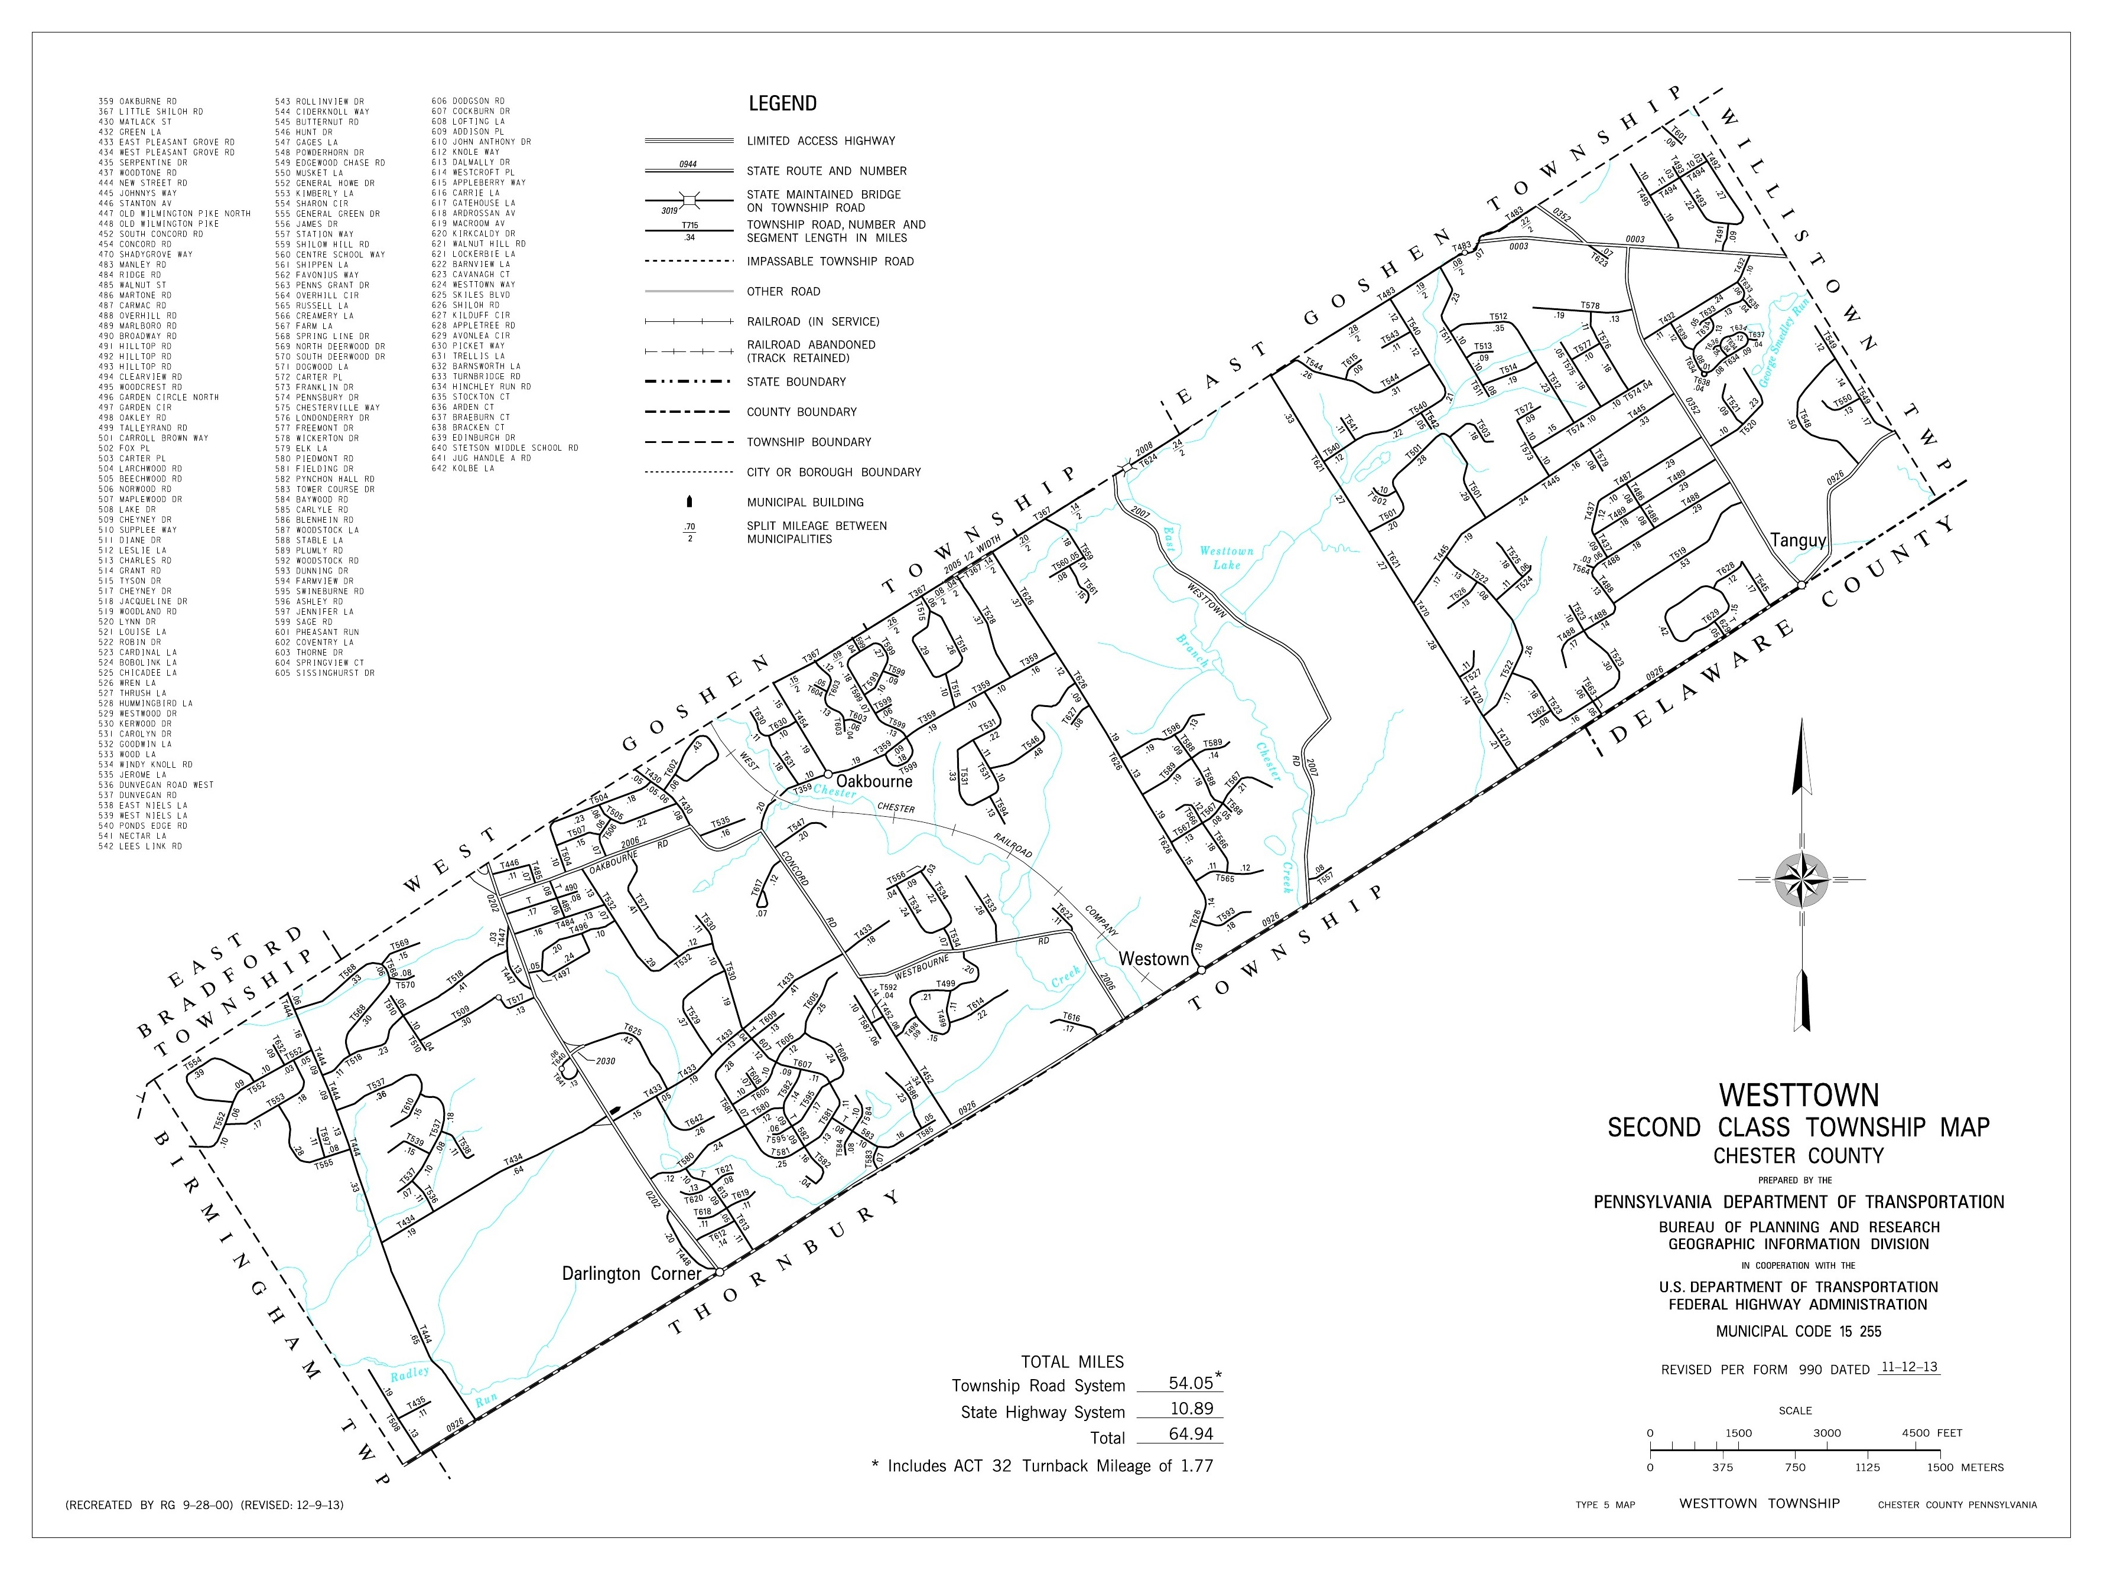
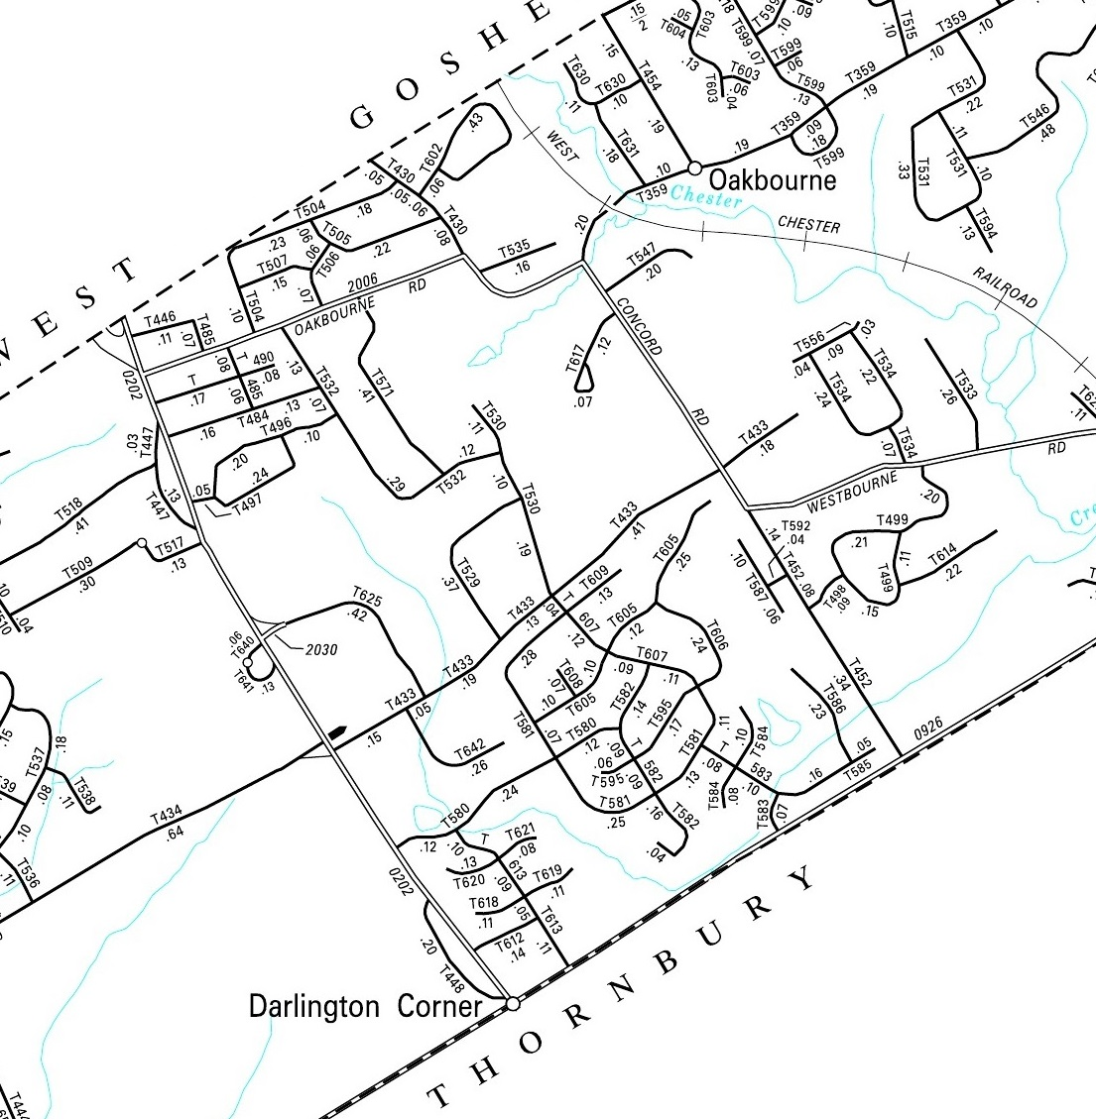
State Roads
Within Westtown, the state only maintains 10.89 miles of roads while the Township maintains 54.60 miles.
On the map, all Township roads are indicated with a “T” prefix.
Local Roads

Slide 7
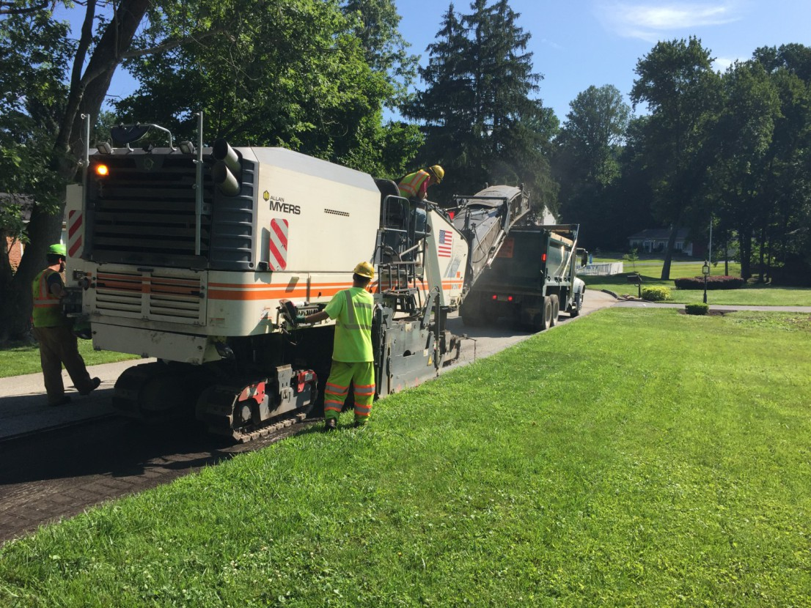
Local Roads - Maintenance
All maintenance and upkeep of local roads are the responsibility of the locality in which they are located.
Major projects are identified and scheduled through an annual Road Maintenance Program. This is done in conjunction with the Township Director of Public Works and Township Manager/Director of Engineering.
A crew milling asphalt as part of the 2016 Road Program in Westtown.

Slide 8
Local Roads - Maintenance
The breakdown of annual road maintenance funding for Westtown is as follows:
Funding Type | Allocated monies
General Fund * | $565,925
Liquid Fuels Funds | $360,000
TOTAL | $925,925
In 2016 Westtown spent $925,925 to mill and pave all or parts of sixteen roads, totaling 5.35 miles in length, and make associated drainage improvements.
Funding source was associated with a 1.0 mil increase in real estate taxes passed by the Board of Supervisors in 2012 that is dedicated to road improvements.

Slide 9
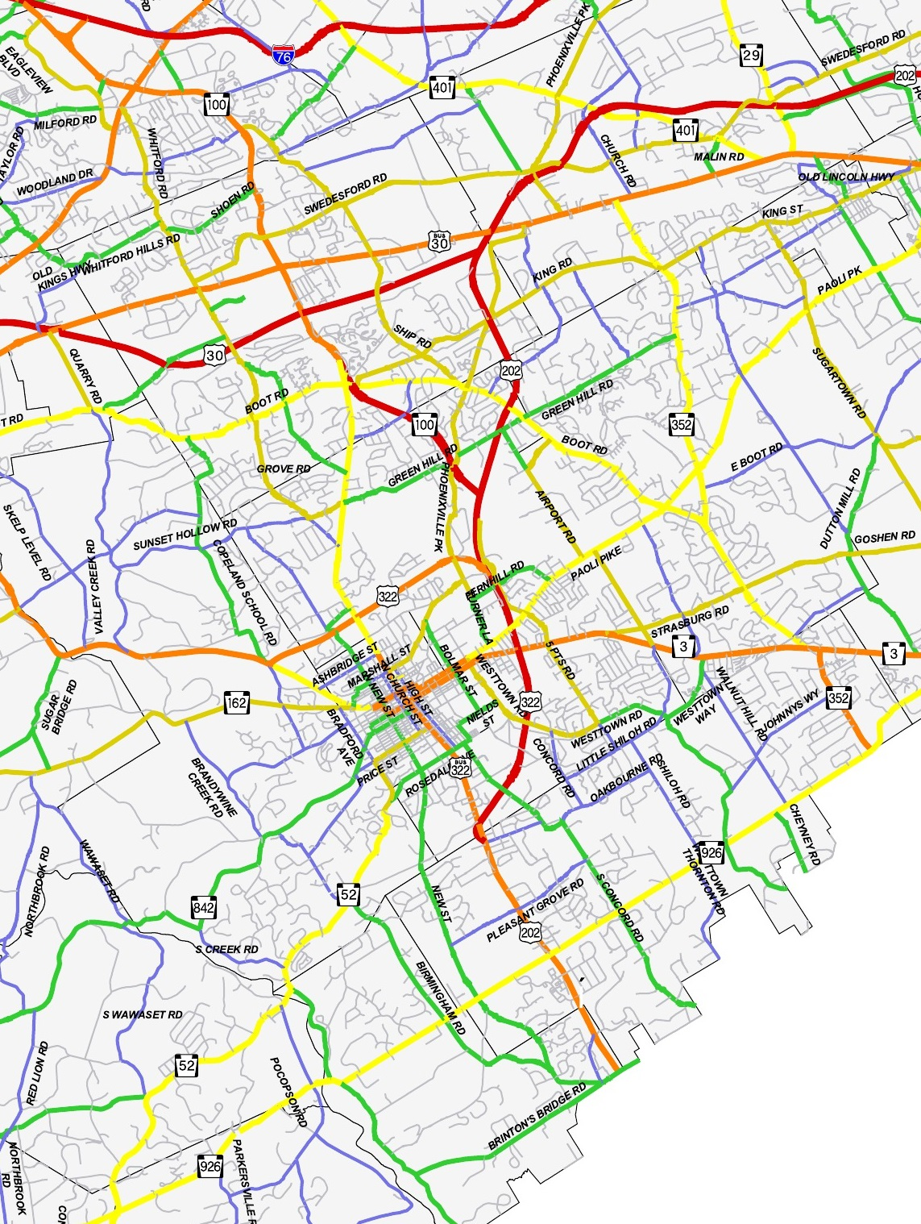
Overview of Township & Borough Responsibilities
Within the Commonwealth, all localities are granted authority to provide for and maintain a network of local roads.
As an example, Westtown is subject to the provisions of the Second Class Township Code. Specific provisions to roads identified in the code are as follows.

Slide 10
Section 2301. Road and Bridge Maintenance, Repair and Construction.-The board of supervisors may purchase or hire materials, equipment, machinery and implements necessary for the construction, repair and maintenance of roads and bridges and make and maintain bridges over streams, gullies, canals and railroads where bridges are necessary for the ease and safety of travelers. The bridges shall be deemed to be a part of the road.
Section 2304. Power to Lay Out, Open, Widen, Vacate, Et Cetera.- The board of supervisors may by ordinance enact, ordain, survey, lay out, open, widen, straighten, vacate and relay all roads and bridges and parts thereof which are located wholly or partially within the township.
Section 2312. Elimination of Curves; Acquisition of Views.- Any township may acquire, by purchase or by the right of eminent domain, any property and lands along or adjacent to any township road that may be necessary to eliminate dangerous curves and widen roads and provide a free and unobstructed view over lands located at or near the intersection of any two roads or highways, or a road and a railroad or railway, or at any curve in any road, for the better protection and safety to the traveling public.

Slide 11
Section 2317. Approval of Plans.- No person shall construct, open or dedicate any road or any drainage facilities for public use or travel without first submitting plans thereof to the board of supervisors for its approval.
Section 2324. Protection of Highways from Snowdrifts.- The board of supervisors may enter private property adjacent to any public road or highway and place thereon a snow fence to within a limit of one hundred feet from the right-of-way line of the public road in order to eliminate snow drifting on the traveled portion of the public road.
Section 2327. Traffic Lights and Signals.-The board of supervisors may provide for the erection, maintenance and operation of traffic lights and traffic signals in accordance with 75 Pa. C.S. (relating to vehicles). (53 P.S. §67327)
Section 2330. Bike Paths.-The board of supervisors may provide for the construction and maintenance of bike paths for the protection or convenience of the traveling public. (53 P.S. §67330)

Slide 12
Regional Planning Efforts
The Transportation Improvement Program (TIP) is developed by the Delaware Valley Regional Planning Commission (DVRPC) as a congressional mandate for projects receive and spend federal transportation funds.
The TIP lists all transportation projects regardless of mode.
The current four-year TIP (FY2015 to FY2018) allocates monies as follows:
46 percent to the Regional Transit Program
41 percent to the Regional Highway Program
13 percent to the Interstate Management Program
At present, four projects located within the West Chester Area Council of Governments are identified in the current TIP.

Slide 13
Westtown – 202 & 926 intersection
This project includes improvements to reduce congestion and increase safety at the intersection of US 202 and SR 926. This will be accomplished through lane reconfigurations, striping, signal upgrades and bicycle and pedestrian improvements.
The roadway improvements will include installation of a southbound right-turn deceleration lane on US 202 and an additional eastbound left-turn lane on SR 926, creating a double left-turn configuration along the eastbound approach onto Route 202 NB.
Pedestrian and bicycle intersection improvements include physical upgrades such as high-visibility crosswalks, ADA ramps, pedestrian landings, sidewalk extensions, as well signal equipment upgrades for pedestrian push buttons, countdown signal heads, and lighting.

Slide 14
Westtown – 202 & 926 intersection

Slide 15
Westtown – 202 & 926 intersection

Slide 16
Westtown – 202 & 926 intersection

Slide 17
West Whiteland – Exton Station
This phased project will provide for the construction of high-level platforms, a station building, bus circulation loops, and a multi-level parking garage at Exton Station on the Paoli-Thorndale Regional Rail Line.
Phase I is presently under construction and, will include the construction of high-level platforms with canopies and wind screens, and a station building. New lighting, signage, security features, and passenger amenities will also be provided as part of the project. The total cost of Phase I is $17.7 million.
Phase 2 includes a fully accessible, multi-level, parking garage with pathways to the station platforms and bus circulation loops with shelters. The total cost of Phase II, in the amount of $39.5 million, is programmed in FY 2018-2022.

Slide 18
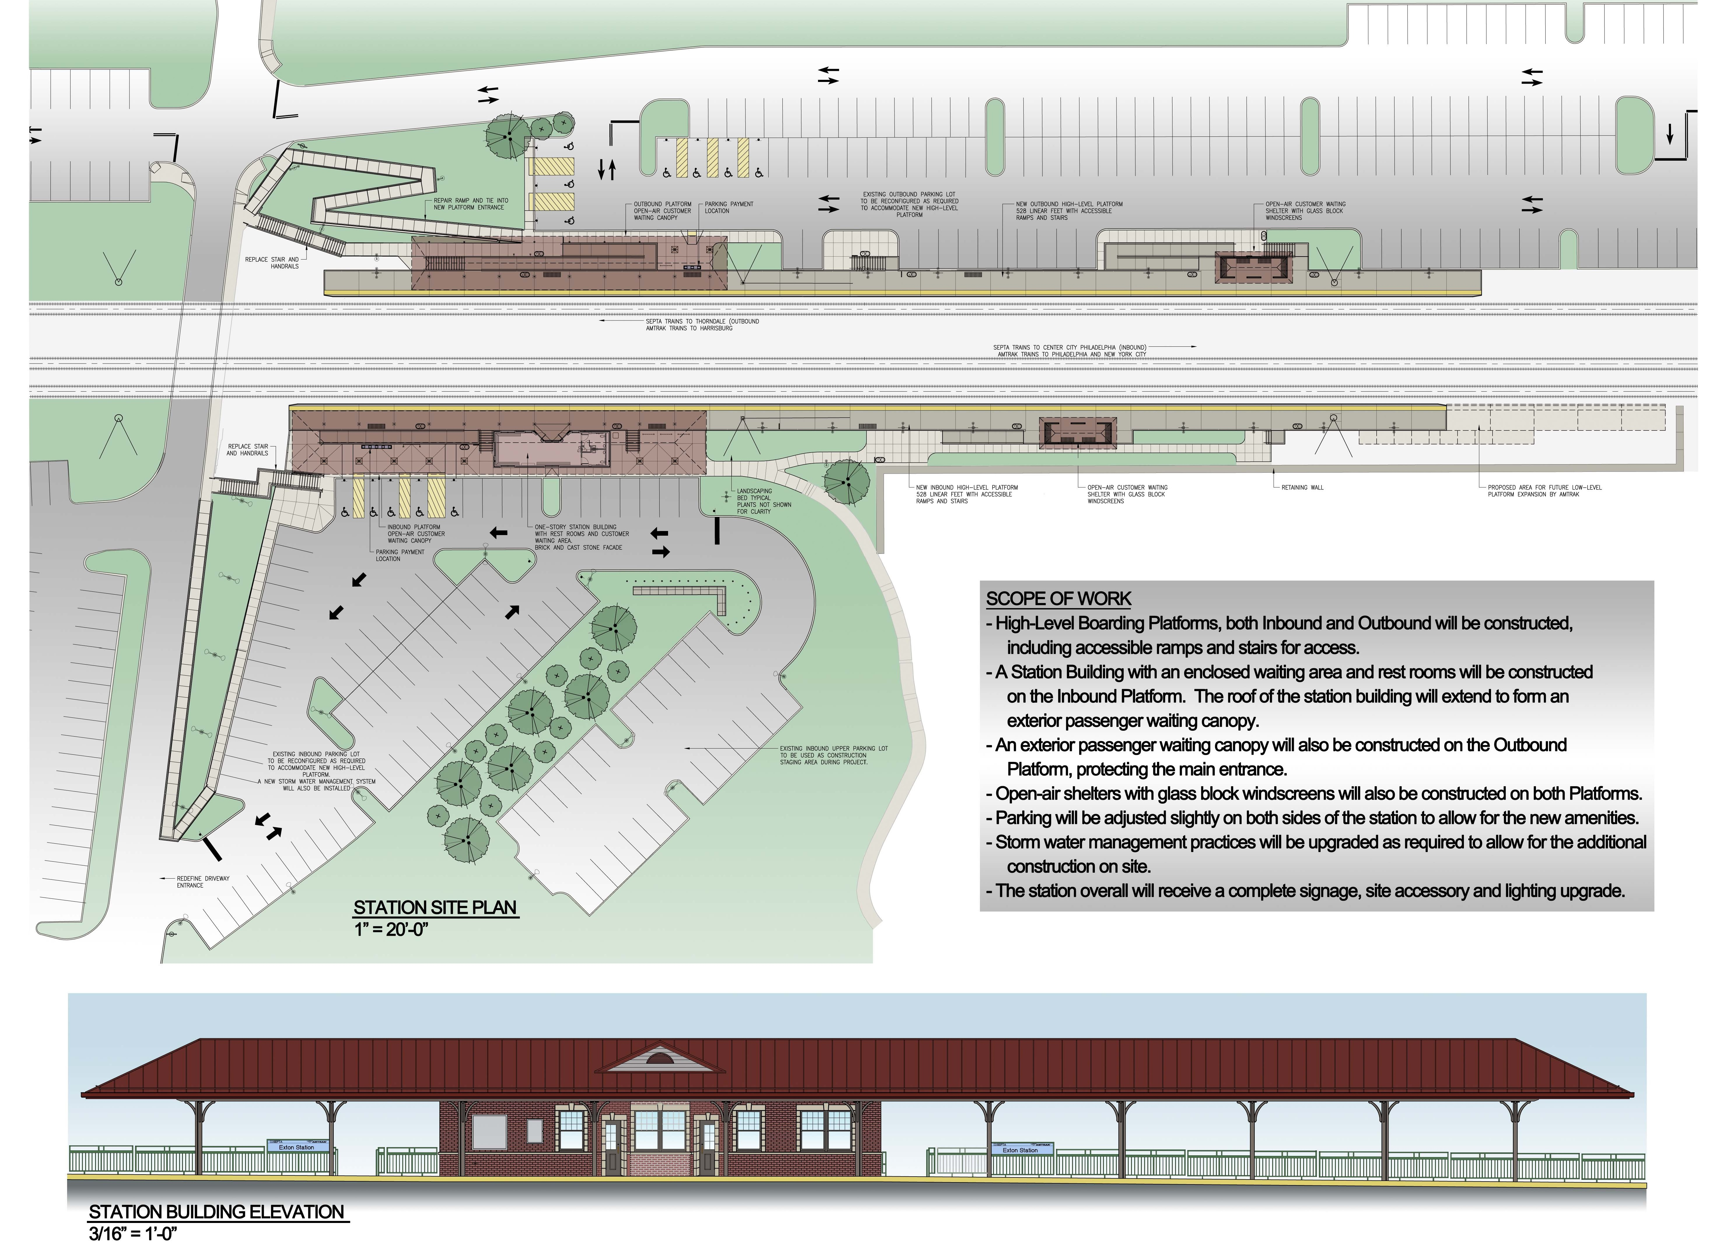
West Whiteland – Exton Station

Slide 19
Regional Multi-use Trails
Multi-use trails are evolving from being just recreational in nature into also serving as a viable transportation alternative.
Examples of regional multi-use trails in the region include:
Schuylkill River Trail
Chester Valley Trail

Slide 20
Schuylkill River Trail

Slide 21
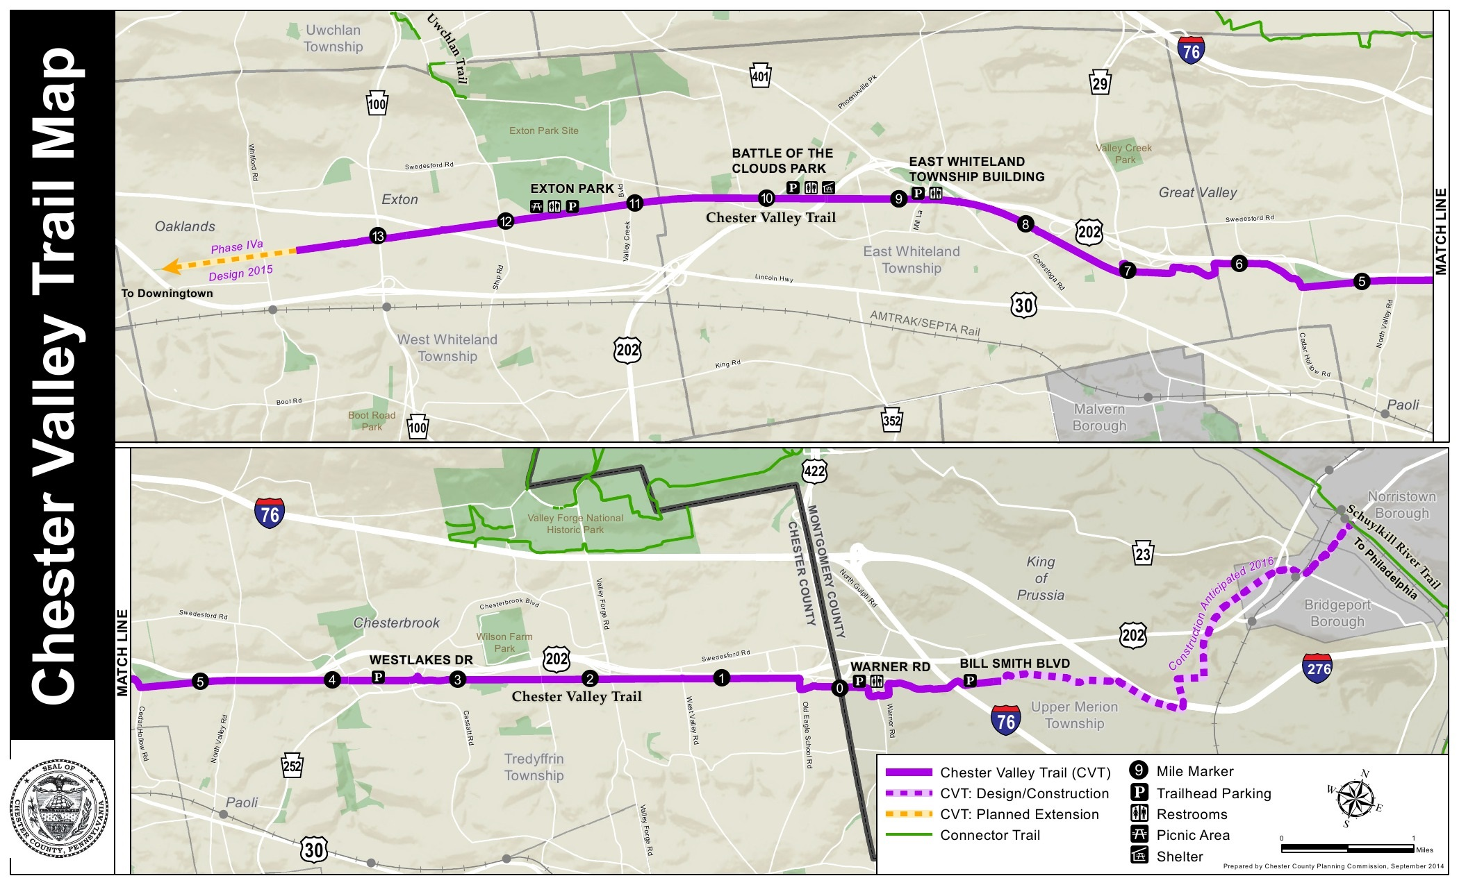
Chester Valley Trail

Slide 22
Traffic Control Signs and Pavement Markings

Slide 23
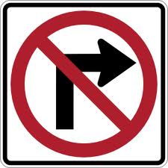
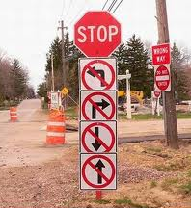
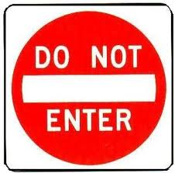
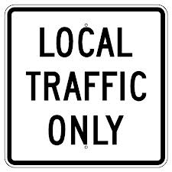
Traffic Control Signs
Notes:
Please, no more stop signs

Slide 24
Pavement Markings
Centerline
Edge lines
Legends
Notes:
Yellow
Single Solid Yellow not permitted
Shall - Paved urban arterials and collectors that have a traveled way > 20 feet and an 6,000 ADT.
Should - Paved urban arterials and collectors that have a traveled way > 20 feet 4,000 ADT.
Should - Rural arterials and collectors that have a traveled way > 18 feet and an 3,000 ADT.
Engineering judgment - traveled ways that are less than 16 feet wide, potential encroachment.
May - other paved two-way traveled ways that are 16 feet or more in width.
White
Shall - Rural arterials with a traveled way > 20 feet 6,000 ADT
Should - Rural arterials and collectors with a traveled way > 20 feet or more in width and an 3,000 ADT
Should - Paved streets and highways where an engineering study indicates a need for edge line markings.
Should not - Providing them is likely to decrease safety.
Option - May be placed on streets and highways with or without center line markings.

Slide 25
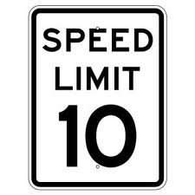
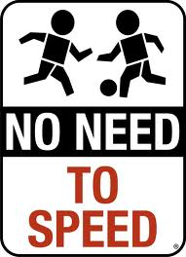
Signs
Notes:
Stop signs not for speeding
Regulations for speed limits

Slide 26
Common Issues
Volume
Speeding
Pedestrians
Accidents
Notes:
Other issues:
- Noise (golf course)
- Trucks

Slide 27
Speed Limits
Statutory Maximums (§ 3362)
35 – Urban District
25 – Residential District
55 – other non-freeway
Traffic Study required…
Notes:
Stop signs not for speeding
Regulations for speed limits
§ 3362. Maximum speed limits.
(a) General rule.--Except when a special hazard exists that requires lower speed for compliance with section 3361 (relating to driving vehicle at safe speed), the limits specified in this section or established under this subchapter shall be maximum lawful speeds and no person shall drive a vehicle at a speed in excess of the following maximum limits:
(1) 35 miles per hour in any urban district.
(1.1) 65 miles per hour for all vehicles on freeways where the department has posted a 65-miles-per-hour speed limit.
(1.2) 25 miles per hour in a residence district if the highway:
(i) is not a numbered traffic route; and
(ii) is functionally classified by the department as a local highway.
(2) 55 miles per hour in other locations.
(3) Any other maximum speed limit established under this subchapter.
(b) Posting of speed limit.--
(1) No maximum speed limit established under subsection (a)(1), (1.2) or (3) shall be effective unless posted on fixed or variable official traffic-control devices erected in accordance with regulations adopted by the department which regulations shall require posting at the beginning and end of each speed zone and at intervals not greater than one-half mile.

Slide 28
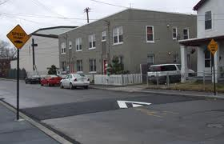
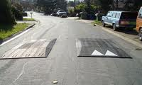
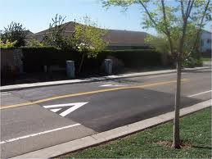
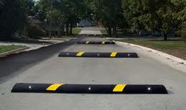
Speed Control
Notes:
Physical Measures, not signage

Slide 29
Residents frequently Request or Demand something to control traffic speeds and volumes.
We have to ask these questions:
Is there a definable problem?
Is there an affordable solution?
Is the solution worse than the problem?
Are there any unintended consequences?
Notes:
Education
Enforcement
Engineering
Avoid unenforceable regulations: stop sign, speed limit

Slide 30
Townships and boroughs have nearly complete control over the placement of traffic control signs and pavement markings on their roads, however they occasionally have to consider Inter-municipal challenges
One example is controlling East-West travel between South New Street and High Street
Rosyln Neighborhood, West Goshen Township
Rosedale Avenue, West Chester Borough/West Chester University
Jacqueline Drive, Westtown Township

Slide 31
Rosedale Avenue
Roslyn neighborhood
Jacqueline Drive

Slide 32
Rosyln Neighborhood, West Goshen Township
Installation of “no thru traffic” signs at the northern intersection of Rosary Lane and South New Street
Installation of “no left turn” signs from Norfolk onto Roslyn Avenue
Installation of a “no U-turn” sign on the south side of the Rosary and Jones Lane intersection
Installation of a “no right turn” sign at both driveways from the parking lot at the northern end of Roslyn Avenue
Installation of “no left turn” sign from Jones to Rosary Lane
Installation of “no thru traffic” signs on Roslyn just south of the intersection with Norfolk Avenue
Installation of “no turn” and “do not enter” signs at intersection with Rosary Lane and South New Street

Slide 33
Rosyln Neighborhood, West Goshen Township
This action by West Goshen Township did not consider the adverse impacts to streets in Westtown and West Chester Borough, and to pedestrian traffic at West Chester University.
These traffic controls were very effective in minimizing cut through traffic in the Roslyn neighborhood, they resulted in significant diversions of traffic to Rosedale Avenue in West Chester and Jacqueline Drive in Westtown.
This resulted in increased traffic volumes, and decreased pedestrian safety and adverse impacts to the quality of life for the people who live along Jacqueline Drive and the students who walk across Rosedale Avenue.

Slide 34
Rosedale Avenue West Chester Borough/West Chester University
A 2013-14 study was undertaken on the Rosedale corridor as a cooperative effort between West Chester borough, West Goshen and West Chester University.
The focus of the study was to perform a traffic feasibility study of traffic and pedestrian improvements along Rosedale Avenue from Route 52 to South Franklin Street.
The report included recommendations for enhanced pedestrian accommodations, signal timings, additional turn lanes as well as further study for the Tigue Road/Stadium Drive corridor.

Slide 35
Jacqueline Drive, Westtown Township
As a result of the Roslyn neighborhood traffic restrictions implemented by West Goshen Township, Jacqueline Drive has experienced a greater number of cars and trucks traveling between South New Street and U.S. 202.
In order to address this growing concern, the Township studied various traffic calming measures to mitigate the impacts of increased traffic.
In 2015 the Township installed an additional stop sign, increased traffic enforcement along the entire road, and installed a digital speed sign and a neighborhood gateway sign.
Speed humps were considered but were not embraced by the residents.

Slide 36
Jacqueline Drive, Westtown Township

Slide 37
Questions?

